Slide 1
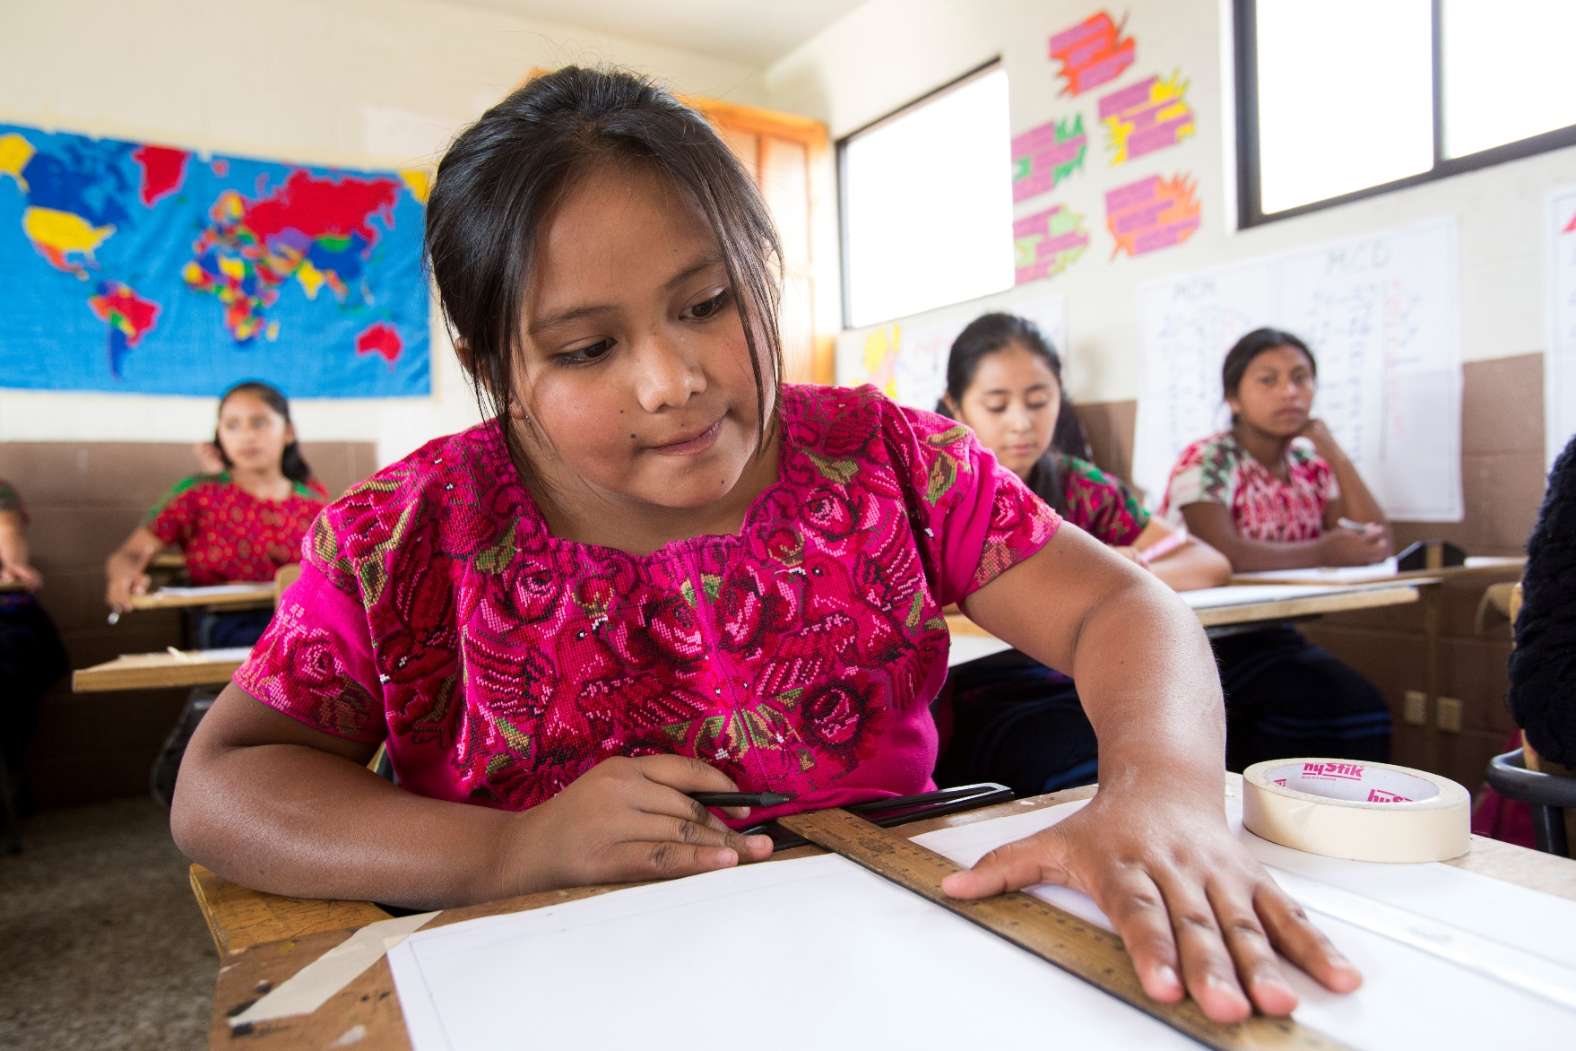

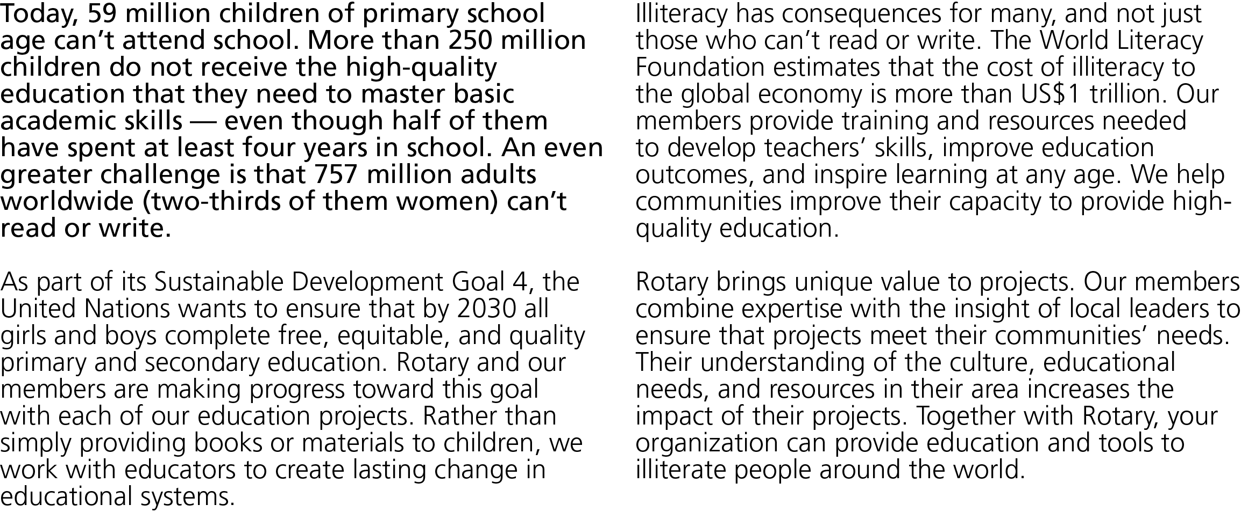


Slide 2
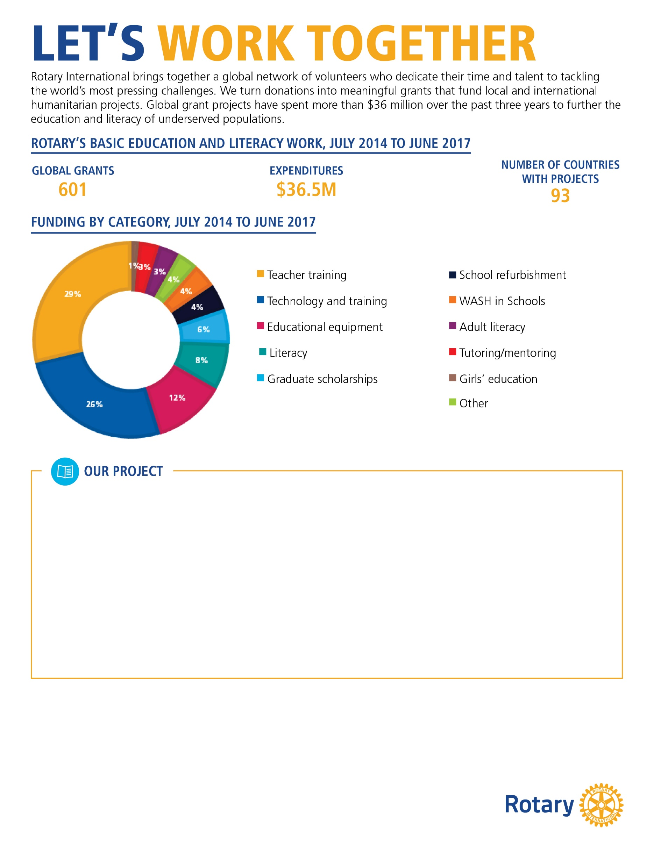
[ In 500 words or less, describe a basic education and literacy project that your club or district either finished or is currently working on. Please use 12-point Georgia font . It’s also a good idea to include photographs of your project. ]
[Your description should include :
The problem your project addresses and how it was discovered
A brief description of your community and how the project benefits it
How the partner organization’s involvement improves the project and its outcome
If the project is complete, its impact on the community (example: trained 100 teachers in science education )
How this project will continue when Rotary’s involvement is over]
[Customizable call to action:]
Get involved with Rotary’s education projects!
Your organization can have a significant impact on literacy in our community. Join a current Rotary project or help us find new opportunities to make a difference. With your support, we can change lives and improve the future for those who are most vulnerable. Contact us at [insert email] or [insert phone number] to learn how you can get involved.

