Slide 1
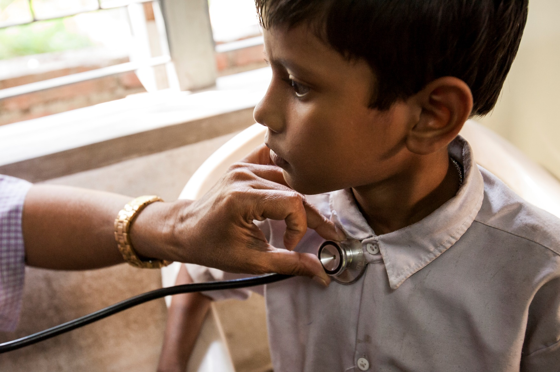


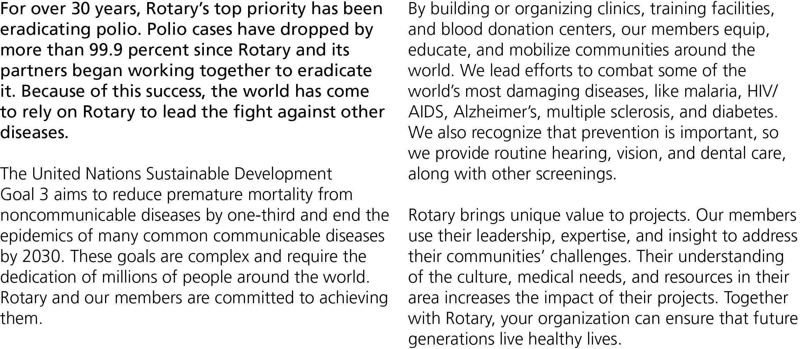


Slide 2
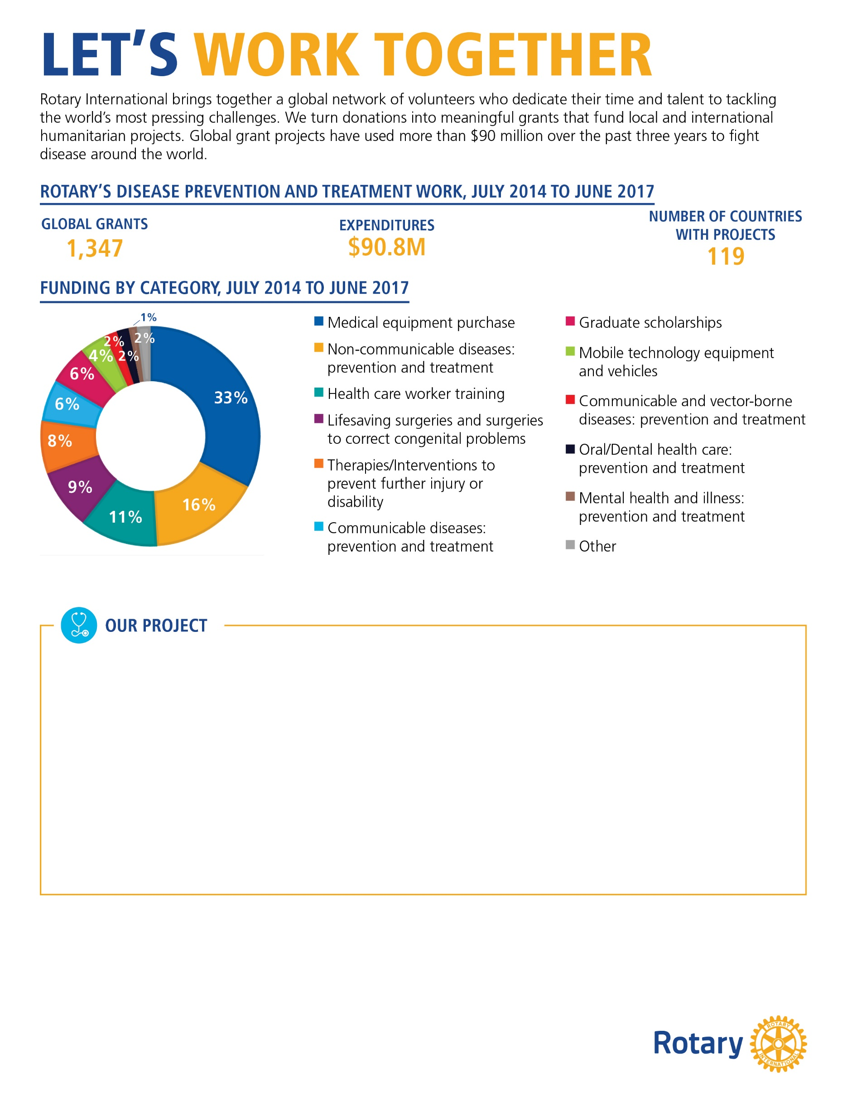
[In 500 words or less, describe a disease prevention and treatment project that your club or district either finished or is currently working on. Please use 12-point Georgia font . It’s also a good idea to include photographs of your project.]
[Your description should include:
The problem your project addresses and how it was discovered
A brief description of your community and how the project benefits it
How the partner organization’s involvement improves the project and its outcome
If the project is complete, its impact on the community (example: trained 50 health care workers)
How this project will continue when Rotary’s involvement is over]
[Customizable call to action:]
Help Rotary fight disease!
Your organization can have a significant impact on the health of people in our community. By working together, we can expand access to quality health care and help prevent devastating illnesses. Contact us at [insert email] or [insert phone number] to learn how you can get involved.

