Slide 1
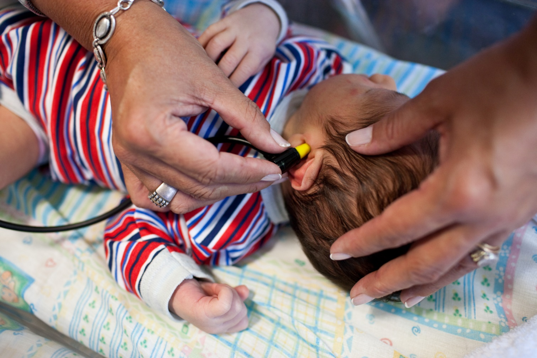


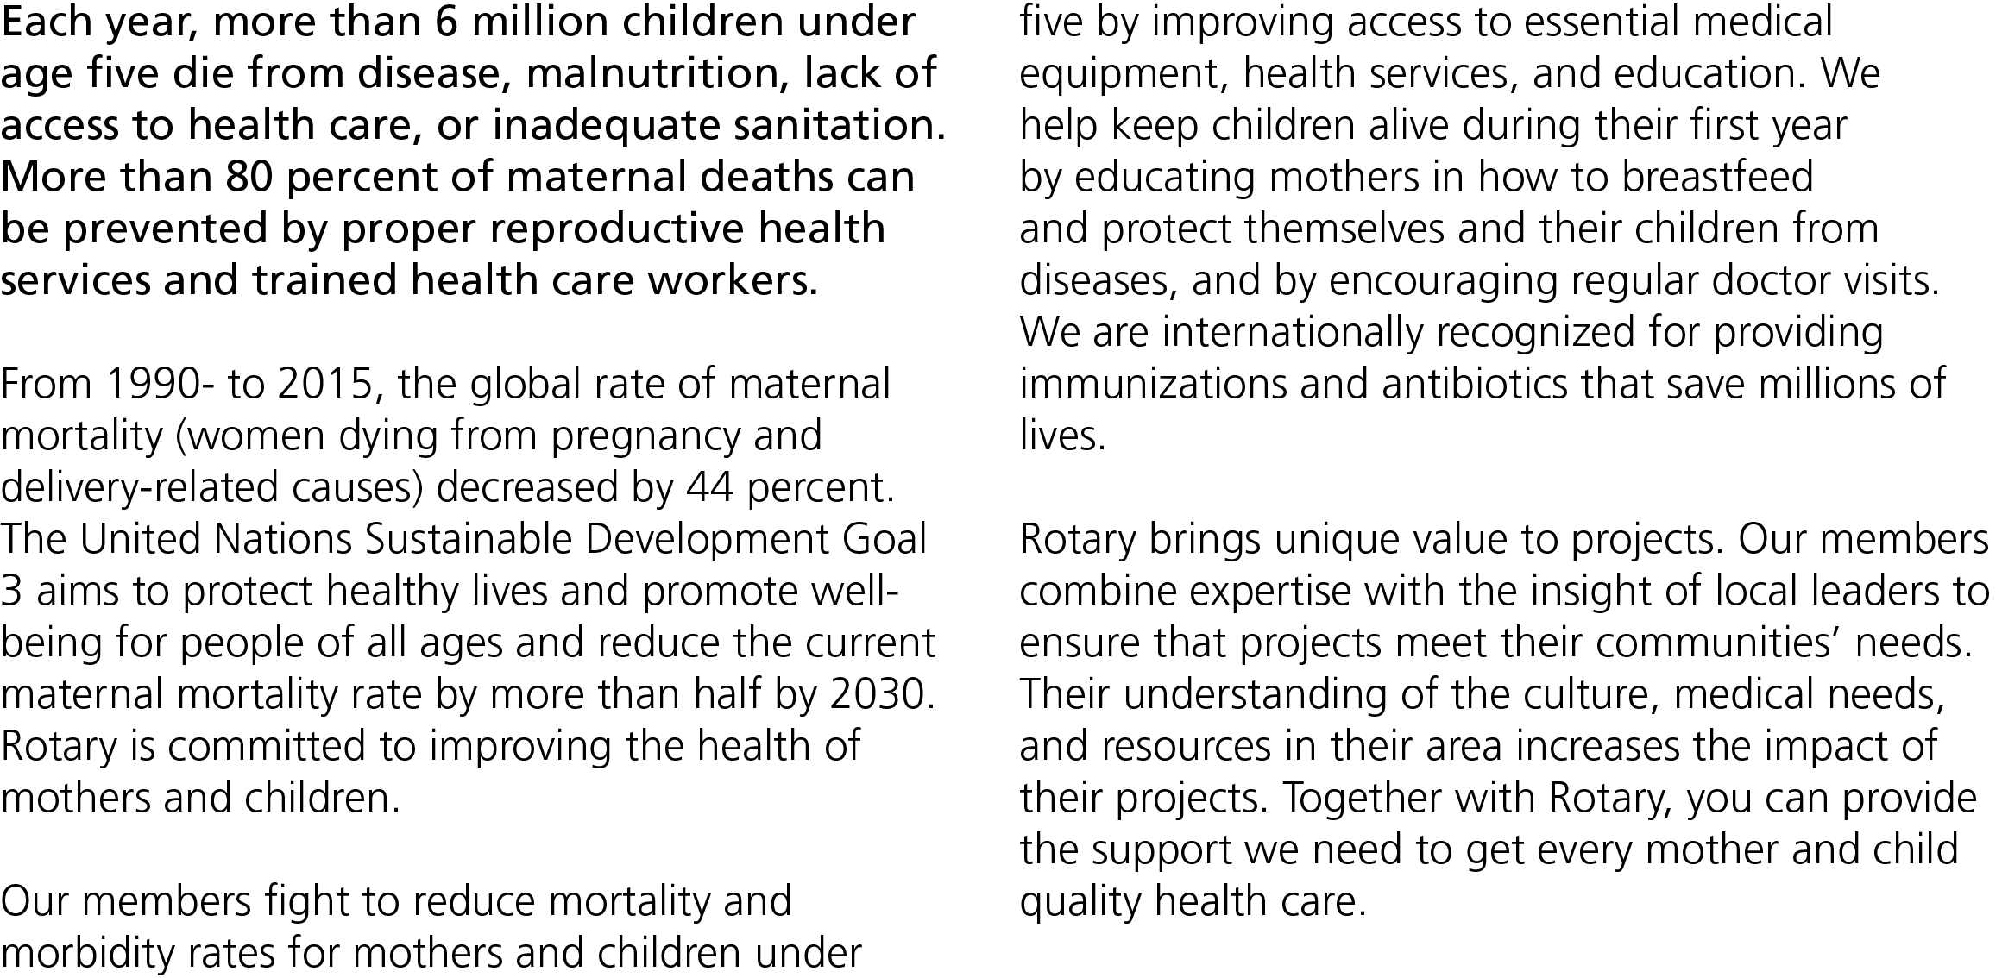


Slide 2
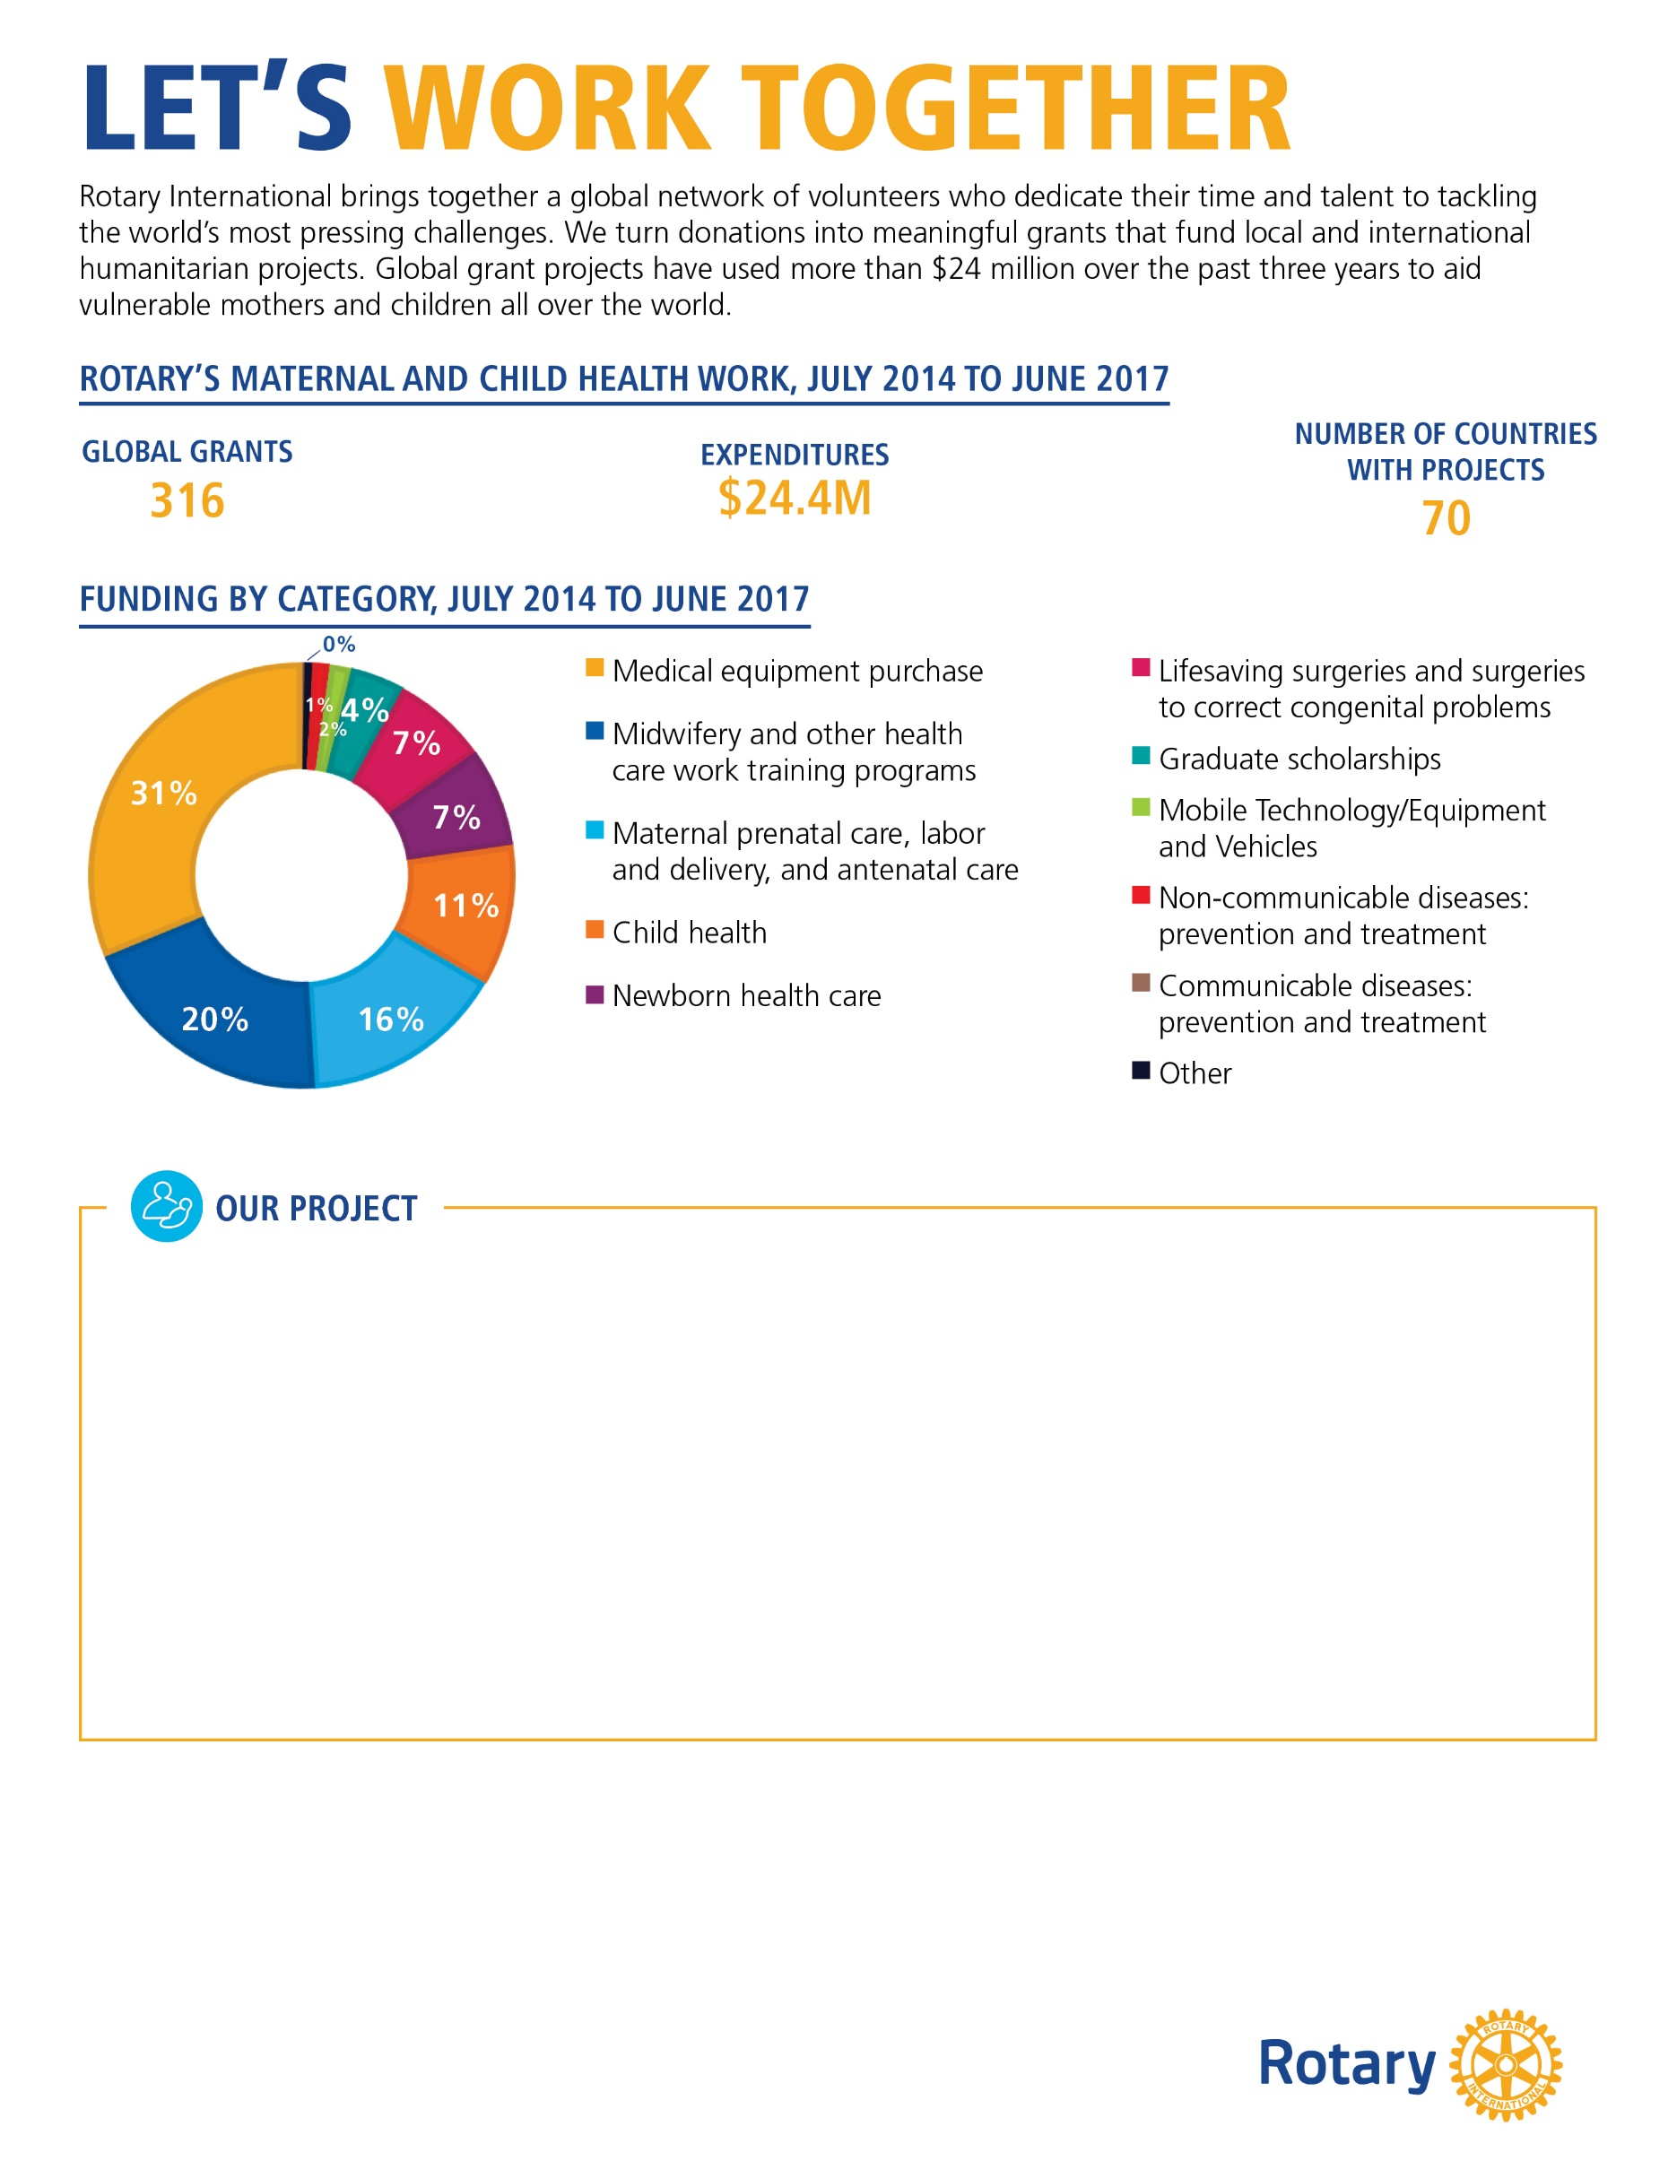
[ In 500 words or less, describe a maternal and child health project that your club or district either finished or is currently working on. Please use 12-point Georgia font . It’s also a good idea to include photographs of your project. ]
[Your description should include :
The problem your project addresses and how it was discovered
A brief description of your community and how the project benefits it
How the partner organization’s involvement improves the project and its outcome
If the project is complete, its impact on the community (example: trained 100 midwives )
How this project will continue when Rotary’s involvement is over]
[Customizable call to action:]
Help Rotary improve the health of mothers and children!
Your organization can have a significant impact on the health of mothers and young children throughout [insert country]. Join us in expanding access to quality health care and providing education and training opportunities. With your support, we can change the lives of those who are most vulnerable. Contact us at [insert email] or [insert phone number] to learn how you can get involved.

